Slide 1
Requirements Collection
OR
Fact Finding Techniques

Slide 2
Software Development Lifecycle (1)
Requirements Analysis: SRS
Design: Design Document
Implementation: Software
Testing
Installation
Maintenance

Slide 3
Software Development Lifecycle (2)
Traditional Iifecycle
  Sequential
  Real projects rarely follow it
Spiral lifecycle
  Suitable for unknown domain
  Partial development of each phase
Prototyping lifecycle
  User involvement large
  User interface issues important
Iterative lifecycle (we are going to follow)

Slide 4
Software Development
Aim should be to produce the system that meets the needs of the people who will be using it
Study of the existing system: computerized/ documents/ manual

Slide 5
Study of Existing System (1)
How existing system works?
Some functionality of the existing system will be carried forward into the new system
Some data in the existing system is valuable for the new system
Technical documents of the existing computer systems may provide details of processing algorithms
The existing systems may have some defects which should be avoided in the new system

Slide 6
Study of Existing System (2)
Studying the existing system will help us understand the problem domain in a better way
Parts of the existing systems may be retained
The baseline information about the existing system will help in setting performance targets for the new system

Slide 7
Analysis & Design (1)
Analysis: A description of the problem & requirements: what the problem is about and what a system must do?
Design: High level & detailed descriptions of the logical solution & how it fulfills requirements & constraints

Slide 8
Analysis & Design (2)
Analysis
What
Requirements
Investigation of domain
Design
How
Logical solution

Slide 9
Analysis (1)
A description of the problem & requirements: what the problem is about and what a system must do.
Analysis emphasizes an investigation of the problem rather than finding a solution
Information Gathering
Specification: modeling requirements & constraints
The product of analysis stage is System’s Requirements Document (SRS).

Slide 10
Analysis (2)
Problems
  Communication gap
  Facts will rarely emerge in a neatly ordered fashion
  Facts found by the developers are usually detailed, unstructured and sometimes conflicting
  Clear, precise documentation

Slide 11
Requirements (1)
Create a specification of the problem domain & the requirements from the perspective of
  Classification by objects
  Understanding the terms used in the problem domain
Conceptual model does not describe software components, it represents concepts in real-world problem domain

Slide 12
Requirements (2)
Understanding the requirements includes understanding the domain processes & the role of the external entities
Functionalities/Use Cases: Textual narrative descriptions of the processes in an enterprise or system

Slide 13
Requirements(3)
Example
Place an order
Description: A customer calls a sales representative to request a purchase of one or several products. The representative records the customer and product information.

Slide 14
Requirements (4)
Functional: what a system does or is expected to do ( functionality)
  Descriptions of the processing the system will be required to carry out
  Details of the inputs for the system
  Details of the outputs expected from the system
  Details of the data that must be held in the system

Slide 15
Requirements (5)
Nonfunctional : these describe the aspects of the system that are concerned with how well the system provides the functionality
Performance criteria such as the response time for the updation of the data or retrieving the data
Anticipated volumes of data
Security considerations

Slide 16
Fact Finding Techniques
Requirements Collection
Background Reading
Interview
Observation
Questionnaire

Slide 17
Fact Finding Techniques (1)
Requirements Collection Techniques
Background reading
  Company reports
  Organisation charts
  Policy manuals
  Job descriptions
  Reports
  Documentation of the existing system

Slide 18
Fact Finding Techniques (2)
Interviewing
  Most widely used fact finding technique
  Questionnaires are used if the interviewees are geographically dispersed( video conferencing??)
  Requires good planning, alertness, good interpersonal skills

Slide 19
Fact Finding Techniques (3)
Observation : watching people carrying out their job in natural setting
  Can sort out conflicting information gathered during interviews

Slide 20
Fact Finding Techniques (4)
Questionnaires
  Do you print reports from the existing systems? (Y/N)
  How many students are expected to register? (Multiple Choice)
  How satisfied are you with respose time of the present system (Scaled)
  Additional reports you would like to have (Open Ended)

Slide 21
Documenting Requirements
Records of interviews and observations
Details of the problem
Copies of the existing documents
Details of requirements
Details of users
Minutes of meetings
(papers/files/reports/digital)

Slide 22
Documenting Requirements
Documentation should follow organizational standards
CASE tools are usually used to draw the diagrammatic models and to maintain associated data (about various things shown in the diagrams) in a repository
Digitally stored documents using document management system and a version control system

Slide 23
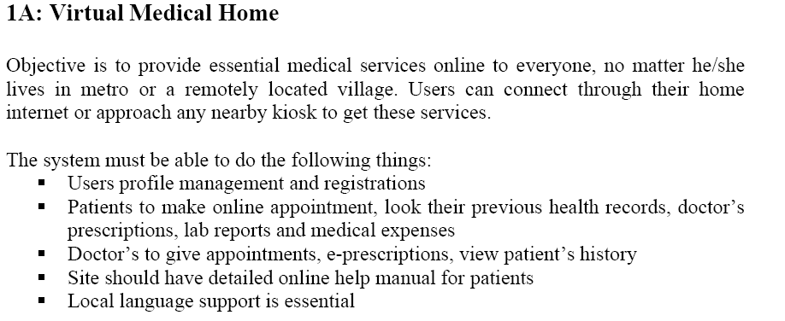
Sample Problem Statement

